Slide 1
Civic Learning Guidebook Instructional Guidance for All Teachers
[This slide deck is meant to serve as a turn-key tool for educators to share with their teams whether at the LEA or school level. It can be used to help with understanding of and planning for the implementation of civic learning. There is also a recorded version of this presentation available. See notes sections for talking points.]

Slide 2
Agenda
Introduction to the Guidebook
Parts of the Guidebook
Overview of Civics Proficiency Requirements
Instructional Vision
Civic Learning Practices
Civic Action Projects

Slide 3
Acknowledgements
Notes:
Thank you to those who contributed to the Civic Learning Guidebook and provided feedback throughout the process including many individuals inside RIDE, members of the Rhode Island History Social Studies Advisory Committee and other educators from across the state. Their dedication to improving civics education in Rhode Island is a testament to the power of civic engagement and the importance of preparing the next generation to lead with knowledge, empathy, and action.
The Civic Learning Guidebook was proudly supported by ServeRI, the state commission for national and community service, under an AmeriCorps Grant.
The document was developed in collaboration with the Rhode Island Department of Education and Heather Van Benthuysen, EngagEd Collective Consultancy.

Slide 4
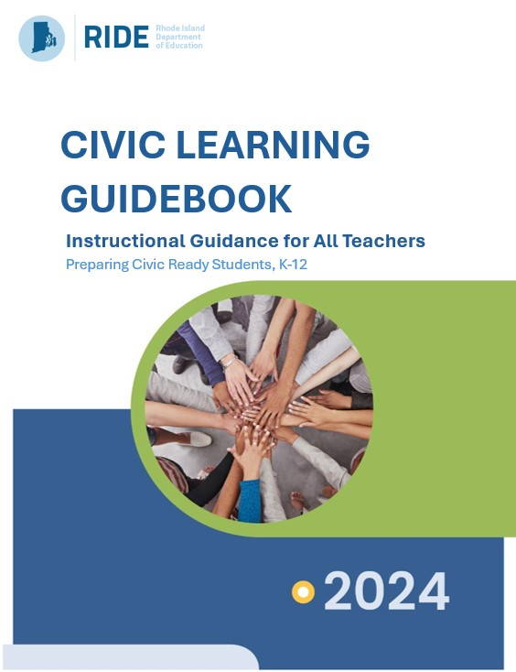
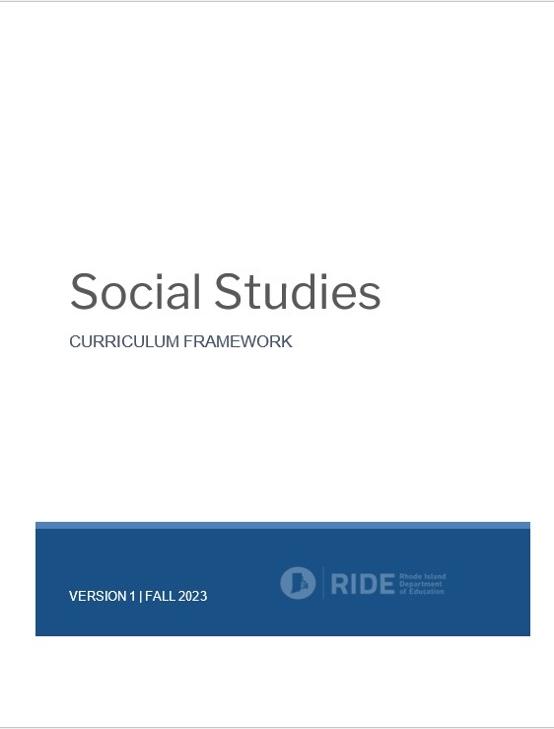
RI Social Studies Standards - February 2023
Social Studies Curriculum Framework - January 2024
Civic Learning Guidebook - September 2024
Notes:
{This slide is animated, click to advance}
The Rhode Island Social Studies Standards, published in Feb. 2023, established a set of anchor standards that appear across all grade levels and increase in rigor over K-12. Civics is one of the domains of the anchor standards and three anchor standards are devoted to civics. This already establishes civics education throughout K-12. In addition, there are civics-related content standards woven throughout K-12. Students progressively learn about rules and laws and their rights and responsibilities from their classrooms to their place in the world and there is a specific focus on state and US government and civics in grade 8 and a model high school civics course.
{click} The Social Studies Curriculum Framework was published in January of 2024 and sets recommendations and expectations for the implementation of the standards K-12 with respect to curriculum, instruction, and assessment. It includes specific recommendations for high school coursework, including Civics, and guidance for when the civics project required by legislation could be implemented.
{click} The Civic Learning Guidebook builds on those two documents. The Civic Learning Practices outlined in the Guidebook build on the high-quality instructional practices of the Curriculum Framework and the Guidebook contains more guidelines for civic action projects – which are not just for middle and high school. (more on that later)
RIDE does not view civics proficiency for a student as a box to check off. RIDE’s vision is for civics instruction to be integrated throughout K-12, to truly prepare our students for their college, career, and civic lives. (This means that K-12 teams need to work together.)

Slide 5
Sections of the Civic Learning Guidebook
Part 1 of the Guidebook introduces what the Guidebook is and its parts
Part 2 of the guide outlines the instructional vision for civics education in Rhode Island and introduces the Rhode Island Civic Learning Practices
Part 3 of the guide takes a deep dive into the Rhode Island Civic Learning Practices and includes guidance surrounding the Practices along with instructional tools and resources
Part 4 focuses on the implementation of civic action projects which take two forms as Taking Informed Action Projects and Civics Capstone Projects.
Notes:
Overview of the sections of the Guidebook

Slide 6
Part 2
21st Century Civics Instruction for Rhode Island Students
Notes:
Part 1 of the document lays out much of what we have covered thus far in this introduction so we will continue with Part 2

Slide 7
Civics Proficiency Requirements
Civics Education Legislation {RIGL§16-22-2} establishes that:
“…civic education standards shall be used in the public schools of this state beginning in kindergarten and continuing through to and including grade 12.”
“All middle and high school students…shall demonstrate proficiency, as defined by the local school district, in civics education…”
“Each public school district shall provide not less than one student-led civics project for students during either middle or high school…”
Notes:
Rhode Island’s civics education legislation {RIGL §16-22-2} requires that all students demonstrate proficiency in civics to graduate high school. To support students’ demonstration of civic proficiency, civic education standards are woven throughout kindergarten to high school and LEAs (Local Education Agencies) must “provide no less than one student-led civics project for students during either their middle or high school.”

Slide 8
Civics Proficiency Requirements
RI Readiness Based Graduation Requirements establish that:
“Students shall successfully demonstrate proficiency in [civics beginning with the class of 2028] to provide them real-world relevant skills that will develop skills and support their success in participating in society…”
Notes:
RIDE’s Readiness-Based Graduation Requirements also requires that all students, beginning with the class of 2028, demonstrate proficiency in civics to graduate high school.

Slide 9
Civics Proficiency Requirements
To meet the proficiency requirement:
Rhode Island Social Studies Standards have established that civics and government is taught in grade 8
Social Studies Curriculum Framework recommends that LEAs also offer a stand-alone civics course in high school
The Standards outline standards for such a high school course
The Civic Learning Practices in the Civic Learning Guidebook work together with the Standards to incorporate civics learning K-12
Notes:
The Rhode Island Social Studies Standards, the Social Studies Curriculum Framework, and the Civic Learning Guidebook all work together to ensure student success in meeting these requirements.
To meet the proficiency requirement:
• The Rhode Island Social Studies Standards have established that civics and government is taught in grade 8, setting up LEAs for success in giving all students the opportunity to meet the proficiency requirement (refer to pages 170-192 of the Standards).
• While it is not required that students take a stand-alone civics course, the Social Studies Curriculum Framework recommends that LEAs also at least offer a stand-alone civics course in high school to capture the students who moved into the district from out-of-state after grade 8 (refer to pages 36-37 and 41-42 of the Curriculum Framework).
• The Rhode Island Social Studies Standards have outlined standards for a stand-alone high school civics course (refer to pages 193-225 of the Standards).
• Furthermore, the Civic Learning Practices outlined in Part 3 of the Civic Learning Guidebook are designed to be incorporated throughout K-12, and the civics-based anchor and content standards of the Standards are woven throughout K-12 grade and course themes. These work in concert to establish civic proficiency in our students even before high school and work above and beyond legislative and graduation requirements. This contributes to RIDE’s instructional vision for Rhode Island civic learning that will be explain in a few slides, and RIDE’s definition of a civic-ready student.

Slide 10
Civics Proficiency Requirements
To meet the requirement of the student-led civics project:
The Social Studies Curriculum Framework recommends that LEAs use the grade 8 focus on civics as an opportunity to fulfill their requirement to provide the project
The Social Studies Curriculum Framework also outlines recommendations for LEAs on when to offer the project based on their choice of whether or not they decide to require students take a civics course in high school
Part 4 of the Civic Learning Guidebook is dedicated to RIDE’s recommendations and instructional guidance for what the student-led civics project should look like
Notes:
To meet the requirement of the student-led civics project:
• The Social Studies Curriculum Framework recommends that LEAs use the grade 8 focus on civics and government as an opportunity to fulfill their requirement to provide a student-led civics project (refer to page 36 of the Curriculum Framework).
• The Curriculum Framework also outlines recommendations for LEAs on when to offer the project based on their choice of whether or not they decide to require students take a civics course in high school. (Please refer to the Curriculum Framework pages 41-42 for those recommendations.)
• Part 4 of the Civic Learning Guidebook is dedicated to RIDE’s recommendations and instructional guidance for what the student-led civics project should look like. In fact, Part 4 establishes two types of civic action projects – Taking Informed Action Projects and Civics Capstone Projects with the Capstone representing the project required for graduation. RIDE’s vision is that students will have practiced throughout their schooling with Taking Informed Action Projects before completing the Civics Capstone Project as their graduation requirement – These two types of projects will be explained later in this presentation.

Slide 11
Civics Proficiency Requirements
Of note:
LEAs can opt to allow a high school Civics Capstone Project to fulfill a students’ performance-based diploma assessment requirement
Schools and districts will need to record students who have met the civics proficiency and civics project requirements using their existing systems
LEAs can opt to accept student projects that are completed outside of school.
Notes:
Of note:
• LEAs can opt to allow a high school Civics Capstone Project to fulfill a students’ performance-based diploma assessment requirement.
• Schools and districts will need to record students who have met the civics proficiency and civics project requirements using their existing systems, like other graduation requirements. LEAs could leverage the ILP for this purpose as well.
• LEAs can opt to accept student projects that are completed outside of school, such as through an afterschool, Girl Scouts / Scouts BSA, or other civic-oriented program. Students should be able to demonstrate that the project meets the requirements of a student-led civics project as established in Part 4 of this Guidebook.

Slide 12
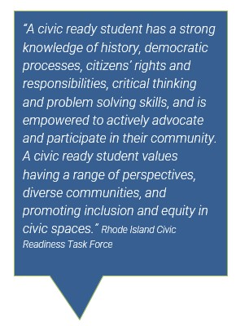
Vision and Definition
The expectation for civic learning extends beyond the grade 8 and high school civics courses, aiming for a seamless integration of civic knowledge and skills across the entire social studies curriculum from kindergarten to high school.
Notes:
Reiterating that the vision is for civic learning to occur across the entire social studies curriculum from kindergarten to high school. This goes hand-in-hand with this definition of a civic ready student that was developed by the Rhode Island Civic Readiness Task Force. This definition also appears in the Social Studies Curriculum Framework as part of the vision for student success in social studies.

Slide 13
Civics Education Versus Civic Learning
Notes:
What is civic learning? While civics education emphasizes the knowledge of civics, for example government structures, how decisions are made, the history of our constitution - which is critical knowledge for effective civic life - civic learning is more focused on the practices and experiences that cultivate the dispositions and values of citizenship.

Slide 14
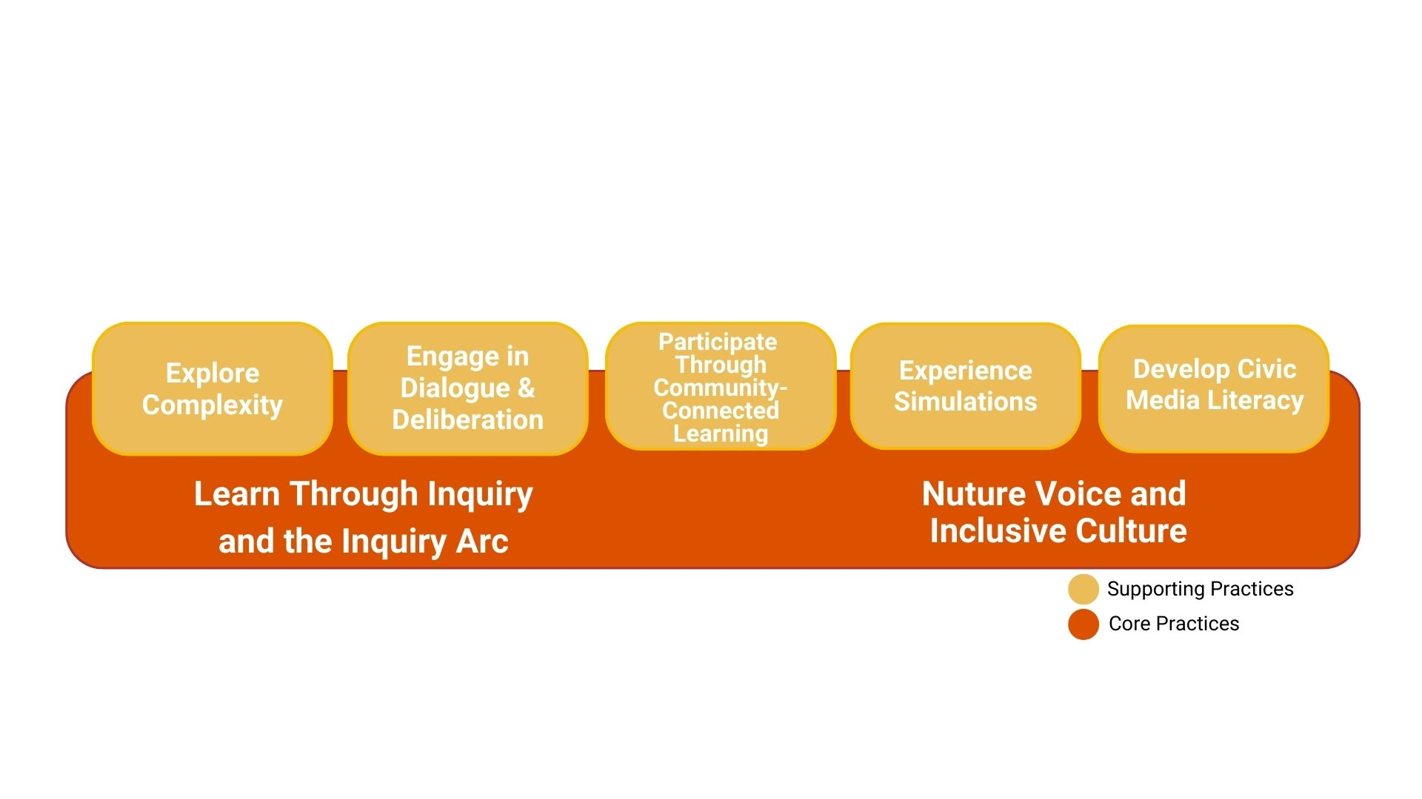
Civic Learning Practices
Notes:
The Guidebook outlines Civic Learning Practices which are divided into two categories:
Core Practices are the essential, daily strategies that provide a strong foundation for student learning. They provide grounding for all classroom instruction and should be the foundation with which all other practices are embedded.
The Supporting Practices are instructional moves and strategies that students should experience regularly in order to develop the skills, knowledge, and competencies necessary to lead powerful and impactful civic lives.
The Guidebook outlines each of these practices and contains links to resources to help educators develop these practices.

Slide 15
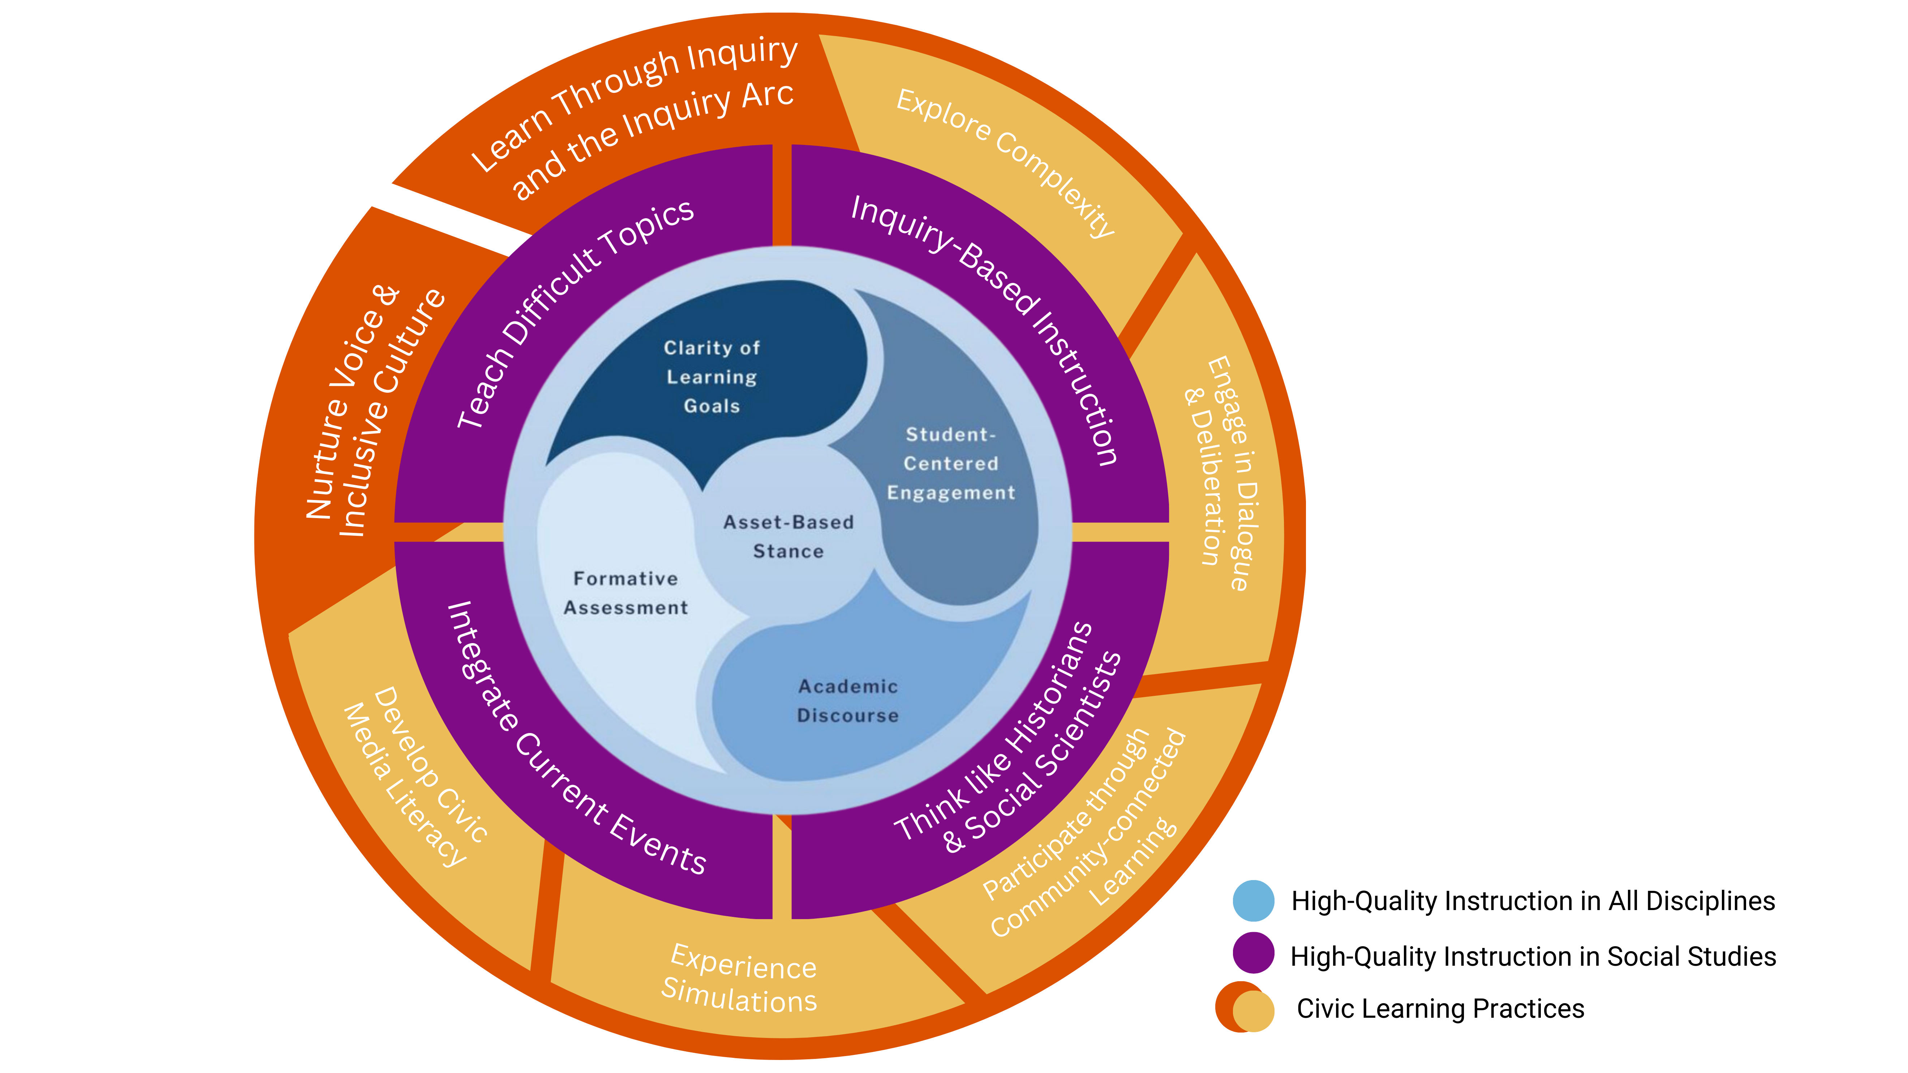
Notes:
The Civic Learning Practices align with and support High-Quality Instructional Practices (HQIPs) for all disciplines (the blue circle) that can be found in all of RIDE’s content-area Curriculum Frameworks. The Social Studies Curriculum Framework builds around these instructional practices with those specific to social studies instruction (the purple ring). Descriptions for each of the High-Quality Instructional Practices can be found in the Social Studies Curriculum Framework.
The Civic Learning Practices (the orange ring) outlined in the Civic Learning Guidebook directly support and extend the Social Studies Curriculum Framework and are foundational to daily civic learning from kindergarten to high school.
Altogether, they articulate the learning experiences every Rhode Island student should be exposed to in social studies. By integrating these practices, educators provide powerful learning experiences that not only adhere to the Social Studies Curriculum Framework's core principles but also engage students in real-world civics.

Slide 16
Part 3
Civic Learning Practices: Guidance, Instructional Tools, and Resources
Notes:
We will now learn about the Civic Learning Practices

Slide 17
Core Practice 1
Learn through Inquiry and the Inquiry Arc
Notes:
Core Practice 1 is Learning through Inquiry and the Inquiry Arc

Slide 18
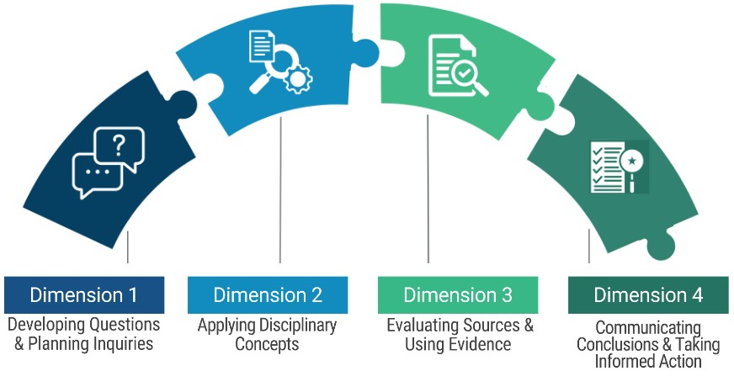
Core Practice 1: Learn through Inquiry and the Inquiry Arc
Credit: C3 Inquiry Arc Framework
Notes:
The inquiry arc comes from the C3 Framework and is a core civic learning practice and learning through inquiry should be incorporated throughout instruction. You will also see later in this presentation that the inquiry arc is foundational for civics action projects. Because it is so fundamental, this presentation spends time to walk through how to use the standards in inquiry and how to incorporate inquiry in practice.

Slide 19
Developing Questions:
Compelling Questions
Supporting Questions
The Inquiry Arc: Dimension 1
Compelling questions launch the inquiry. Students explore, connect with lived experiences & questions
Notes:
The process begins with compelling questions that spark students' curiosity about civics, government, and social problems. Dimension 1 emphasizes the importance of curiosity and questioning. Students learn to formulate compelling questions that are open-ended, thought-provoking, and relevant to their lives. These questions drive the inquiry process. Alongside this, they develop supporting questions to guide their investigation deeper. Planning the inquiry involves strategizing how to explore these questions effectively.

Slide 20
What is a Compelling Question?
What is protest?
When did protests start in America?
Is protest patriotic?
What are famous protests in U.S. history?
A Good Compelling Question:
Invites debate and multiple perspectives
Connects to core values (e.g., patriotism, participation, equality, etc.)
Encourages critical thinking and can be explored at various levels of complexity (e.g., history, civics, economics, geography)
Has relevance to both historical and contemporary contexts
Serves as the glue, connecting the past, present and future to students’ lives and values, and promotes ongoing reflection
Serves as an organizing framework for assessing student understanding at the end of an inquiry unit
Notes:
{This slide is animated-don’t click yet} What is a compelling question? Effective compelling questions are open-ended, arguable, and relevant to students' lives. Compelling questions are built into the Rhode Island Social Studies Standards and can be used to support the inquiry process.
Supporting questions then guide students in investigating the issues and ideas underlying the compelling question. Teachers can develop supporting questions, or better yet, coach students to formulate their own.
{Click} Which of these examples would be a compelling question? Why aren’t the others?
{Click} “Is protest patriotic?” is the compelling question. Another key is that it is an open-ended question while the other questions have defined answers. These other questions could serve as supporting questions and supporting questions can be used to drive research.

Slide 21
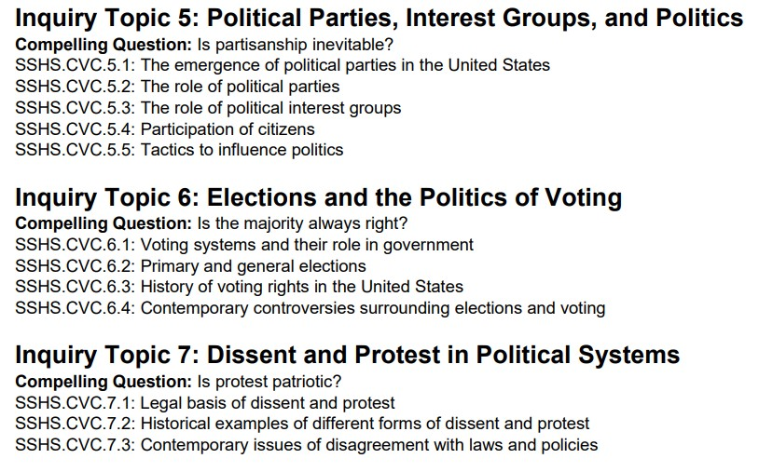
Standards Inquiry Topic Example
Notes:
The Rhode Island Social Studies Standards are grouped into Inquiry Topics with Compelling Questions. In fact, the standards were designed to be explored through the inquiry arc!

Slide 22
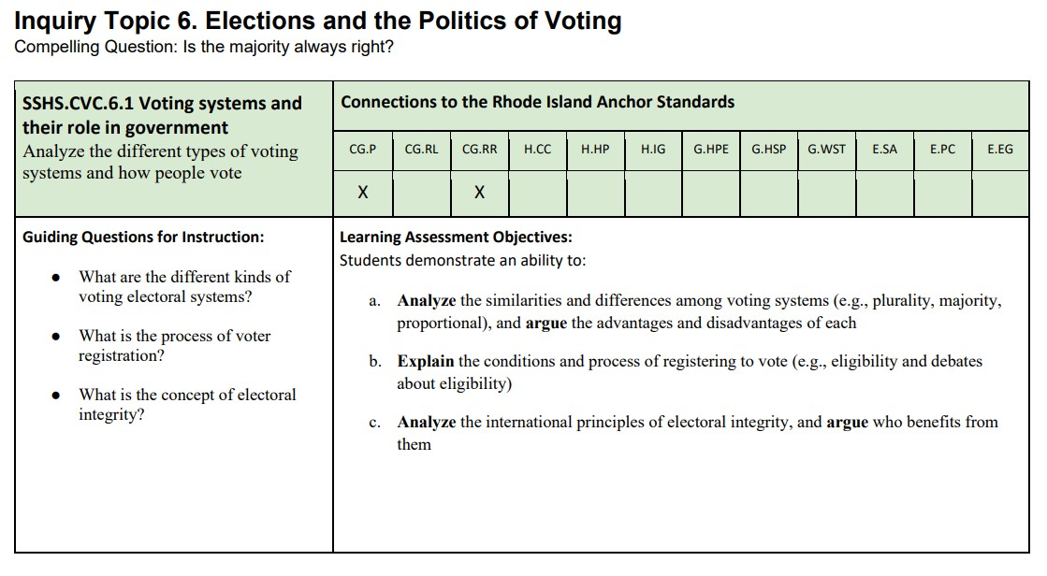
Standards Table Example
Notes:
{Animated Slide} The content standards are then unpacked into a table. The Compelling Questions of the Standards can be used in an Inquiry, and….
{click} The Guiding Questions for Instruction can be used as supporting questions to drive the research process.

Slide 23
Core Practice 1: Learn through Inquiry and the Inquiry Arc
Examples of Compelling Questions from the RI Standards:
Are all communities the same? (Grade 1, Inquiry Topic 5)
Is it possible to ever know the whole truth about the past? (Grade 6, Inquiry Topic 2)
Does a free press support a democratic government? (Grade 8, Inquiry Topic 7)
Is protest patriotic? (High School Civics, Inquiry Topic 7)
Notes:
Here are some examples of Compelling Questions in the Standards. Students can engage in the inquiry process at any grade..

Slide 24
Deepen complex understanding through disciplinary lenses:
Civics
Economics
Geography
History
The Inquiry Arc: Dimension 2
Notes:
In Dimension 2, students dive into the core of social studies disciplines. They apply concepts and tools from history, geography, civics, and economics to their inquiries. This means thinking like historians, geographers, political scientists, and economists, using the specific methods and perspectives of each field to analyze issues and develop a richer understanding. These disciplines provide lenses for analyzing civic issues and making reasoned decisions.

Slide 25
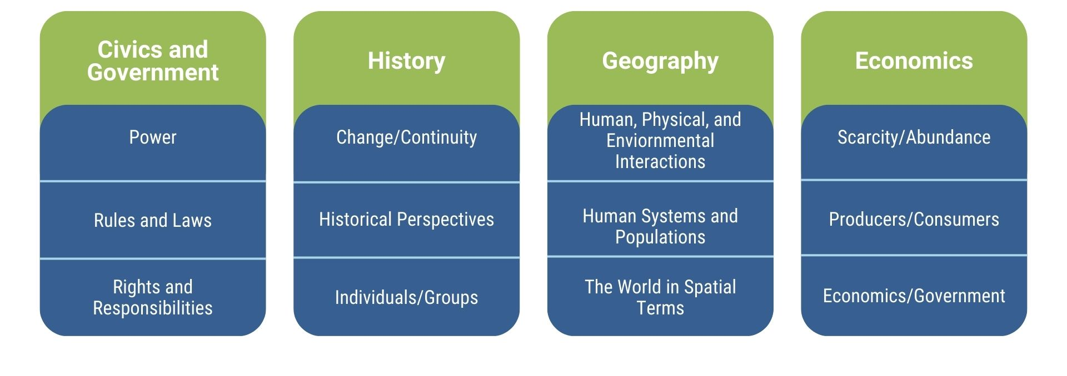
Core Practice 1: Learn through Inquiry and the Inquiry Arc
Dimension 2 of the Inquiry Arc
Notes:
Rhode Island’s Anchor Standards align with the disciplinary concepts of the C3 Framework. Teachers can utilize the standards tables to connect standards within the Inquiry Topic to Dimension 2 research.

Slide 26
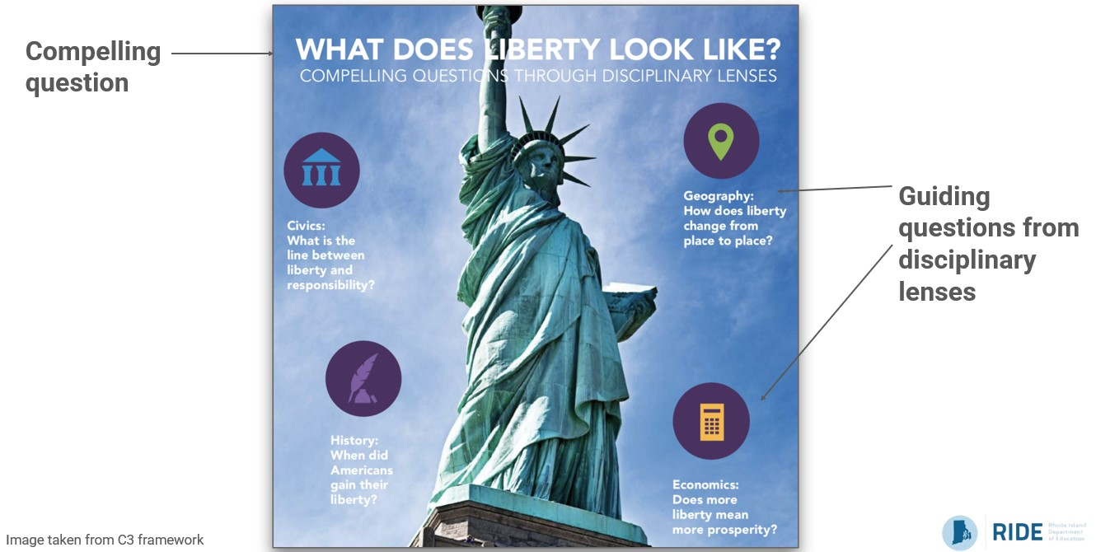
Notes:
In this example from the C3 framework, as students explore the compelling question, "What does Liberty Look Like?” they investigate from different disciplinary lenses. Notice how the supporting questions work together to offer complexity, nuance, and rigor to the compelling question while also practicing different social studies disciplinary skills.

Slide 27
Inquiry Arc of Learning
Notes:
Looking back to “Is Protest Patriotic,” the circles are the standards for the Inquiry Topic “Dissent & Protest in Political Systems” from the Standards for the high school Civics course. The squares are examples of Guiding Questions for each of the standards. Again, these can be used as supporting questions in the Inquiry process. Notice how they work together to build meaning and understanding. While these standards focus on the disciplines of civics and history, students might be interested in exploring further. They can add more supporting questions from disciplinary lenses, or maybe the teacher offers some. For example, from a geographic lens, the question can be asked, “Is protest viewed or treated the same regionally?”
These standards could be taught and met as individual inquiry units or altogether as one long unit. But ultimately, they should all serve as part of a larger inquiry working in service of answering the Compelling Question. The final assessment for this inquiry might be for students to produce an essay, presentation, or class dialogue communicating their conclusions about the Compelling Question.

Slide 28
Grade 8 Example
Inquiry Topic 7: Freedom of the Press and News/Media Literacy
Compelling Question: Does a free press support democracy?
Standards
Civics: Understanding the role of media in democratic processes
Economics: Analyzing the impact of media ownership on information flow
Geography: Investigating global perspectives on press freedom
History: Tracing the evolution of press freedom over time
Notes:
Let’s look at a grade 8 example for another look at Dimension 2. When investigating whether a free press supports democracy, students apply civics standards to understand the role of the media in democratic governance, explore economics standards to analyze the impact of media ownership, use geography standards to examine global perspectives on press freedom, and draw on history standards to trace the evolution of press freedom over time. These disciplinary lenses work together to help students form a well-rounded, evidence-based conclusion.

Slide 29
Students gather, evaluate, and curate sources, developing & supporting claims with evidence.
Credibility
Bias
Perspective
The Inquiry Arc: Dimension 3
Notes:
The third dimension is evaluating sources and using evidence to develop claims. Students learn to analyze a variety of sources, both primary and secondary, like government documents and news articles for credibility, bias, and perspective, synthesizing evidence to support their conclusions. Dimension 3 works in partnership with Dimension 2 as critical thinking takes center stage. By critically evaluating evidence, students can construct well-founded arguments and support their conclusions with solid proof.

Slide 30
Students communicate & critique conclusions in meaningful ways, and take informed action:
Essays
Presentations
Policy Proposals
Civic Action
The Inquiry Arc: Dimension 4
Notes:
Dimension 4, the final dimension, focuses on expression and application. Students learn to communicate their conclusions clearly and persuasively through writing, presentations, or multimedia projects. Beyond sharing findings, they are encouraged to take informed action—applying their new knowledge to real-world situations. This might involve community projects, advocacy, presenting findings to key audiences, or other forms of civic engagement, embodying the role of active and responsible citizens. Students share their findings and extend learning into the real world, practicing civic participation skills to improve their communities.

Slide 31
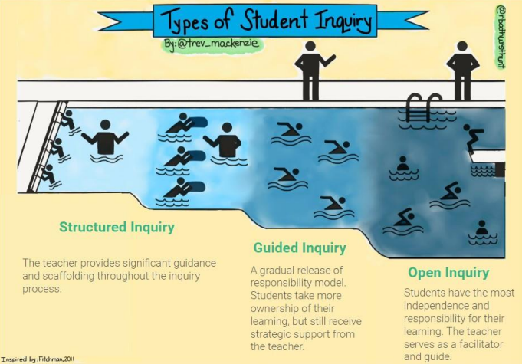
Core Practice 1: Learn through Inquiry and the Inquiry Arc
Scaffolding Inquiry
Meet students where they are
Scaffold learning appropriately
Encourage progression towards independence
Goal: students “swim” on their own
Image adapted from Trevor MacKenzie’s Types of Student Inquiry sketchnote.
Notes:
The Civic Learning Guidebook outlines three types of inquiry. You can think of this analogy of a pool. On the “structured” end, the teacher takes more of the lead. Here, the teacher may supply the compelling question (perhaps one from the standards) and may have selected sources for the research process. On the “open” end, students take the lead. Students may generate their own compelling question and research is open-ended. The level of support can vary in between. When adding inquiry into practice, it is best to start with structured inquiry and move towards open inquiry as students become familiar with the process and progress.
In addition, different students need different levels of support, much like swimmers in a pool. Not all students learn at the same pace or have the same comfort level with inquiry. Some may need the close guidance of the shallow end, while others are ready to explore the depths of the deep end.
The teacher's role is to facilitate this journey, providing support where necessary and encouraging independence when appropriate. The ultimate goal is to help all students learn how to 'swim' on their own—to become independent thinkers and learners capable of conducting open inquiries. This model also helps schools plan horizontally across grades, building in more and more opportunities for open inquiry as students advance.

Slide 32
Core Practice 2
Nurture Voice and Inclusive Culture
Notes:
Having explored how the structure of the Rhode Island Social Studies Standards supports inquiry, let’s now delve into an overview of the other Practices.

Slide 33
Core Practice 2: Nurture Voice and Inclusive Culture
To create meaningful learning experiences that resonate with learners, teachers should prioritize understanding their students' backgrounds, interests, and cultures.
When students see their identities, cultures, and community assets reflected in their learning, they are more likely to feel valued, engaged, and empowered to take action.
By participating in authentic and public experiences, students draw clear connections from their learning and academic content to their lived experience. They gain experience presenting to authentic audiences, enhancing communication and public speaking skills, and develop a sense of civic responsibility and confidence to contribute to their community and society.
Notes:
When teachers nurture student voice and an inclusive culture, they intentionally create an environment where all students feel safe, respected, and affirmed in sharing their voices, perspectives, and lived experiences. This practice positions students as knowledgeable individuals whose identities and ideas deserve to be amplified. Simultaneously, it fosters an inclusive classroom community that encourages risk-taking, provides affirmation, and cultivates a sense of belonging.
This is a core practice for a number of reasons. One, connecting to students’ lived realities makes civics education more authentic, relevant, and empowering. But, more importantly, it is essential to develop and foster an inclusive classroom community in order to successfully incorporate other Civic Learning Practices.

Slide 34
Core Practice 2: Nurture Voice and Inclusive Culture
Notes:
For example, you can’t have successful inquiry without an inclusive environment. You can’t have successful and respectful dialogue without it, etc.

Slide 35
Core Practice 2: Nurture Voice and Inclusive Culture
Nurturing student voice:
Creates a safe and respectful environment
Affirms identities
Amplifies ideas and experiences
Inclusive culture fosters:
Appreciation for diverse perspectives
Engagement across differences
Sense of belonging and empowerment
Notes:
In short,
Nurturing student voice:
Creates a safe and respectful environment
Affirms identities
Amplifies ideas and experiences
Inclusive culture fosters:
Appreciation for diverse perspectives
Engagement across differences
Sense of belonging and empowerment

Slide 36
The Supporting Practices
Notes:
In this next section, we will explore the supporting practices

Slide 37
Supporting Practice 1: Explore Complexity
Avoids oversimplification of complex issues, leading to more nuanced understanding.
Encourages students to consider contexts with perspectives.
Helps students identify and challenge systemic inequities rather than just addressing surface-level symptoms.
Develops students' ability to think critically about real-world problems and propose more effective and actionable solutions.
Prepares students for the complexities of civic life and fosters skills necessary for productive civic discourse and collaborative problem-solving
Notes:
In Supporting Practice 1, educators ensure that curricular content reflects the diverse identities and experiences of students and the rich, complex, and intersectional tapestry of our nation’s history. Educators introduce multiple voices and ideas by developing questions and planning inquiries, applying disciplinary tools and concepts, selecting primary and secondary sources, leveraging local and student lived experiences, oral histories, etc. It includes exploring different perspectives and ideas and questioning and analyzing these elements critically.

Slide 38
Supporting Practice 2: Engage in Dialogue and Deliberation
Both:
Involve exchanging ideas and perspectives
Aim to deepen understanding and promote critical thinking
Involve establishing norms or agreements
Encourage active listening and respectful engagement
Involves listening, sharing, and questioning
Notes:
Engaging in dialogue and deliberation about difficult or controversial topics involves teaching students to respectfully discuss and consider different viewpoints. This practice fosters critical thinking, empathy, and the ability to engage in civil discourse. Facilitating student dialogue provides an opportunity to investigate and deliberate essential questions on topics facing their families and community.

Slide 39
Supporting Practice 2: Engage in Dialogue and Deliberation
Dialogue:
Emphasizes exchanging views
Builds understanding and relationships
Deliberation:
Builds mutual understanding and consensus
Focuses complex policy issues or dilemmas
Weighs options and promotes informed decision-making
Notes:
Supporting Practice 2 focuses on teaching students to engage in mutually respectful and productive discussions about difficult or controversial topics. It emphasizes listening to different viewpoints, articulating one’s own thoughts clearly, and deliberating in a constructive manner to promote mutual understanding and consensus on solutions that are for the betterment of the common good.
Dialogue often precedes deliberation in a comprehensive process.
They are both different than debate which aims to persuade others and asks participants to find ways to win the argument rather than asking them to consider other viewpoints or even change their minds.

Slide 40
Balancing Neutrality & Ethical Responsibility
Promoting free inquiry and deliberation is essential, it's equally important to ensure that classrooms remain safe spaces where students are not exposed to or pressured into accepting harmful, discriminatory, or extremist viewpoints.
Neutrality means allowing students to explore diverse perspectives on controversial topics while recognizing that not all ideas are equally valid or ethical. Issues that undermine the dignity of students or groups are not subject to neutral debate.
Notes:
Educators (and students) are responsible and accountable for creating a safe and productive learning environment. Ideologies that are harmful to students, discriminatory, or extremist can create an unsafe, even hostile environment. These topics have no place in the classroom. While some students and families may hold these views, that is their choice. However, there are limitations to speech in schools - and any speech that can be disruptive or distracting should be restricted.

Slide 41
Supporting Practice 3: Participate through Community-Connected, Relevant Learning Experiences
Builds Understanding of community issues and processes
Builds understanding and relationships
Catalyzes deeper learning and questioning
Reinforces skills for civic engagement
Deepens and connects their learning to the people and places they see everyday
Creates pathways for ongoing civic involvement
Notes:
Supporting Practice 3 contextualizes learning within content, situations, and processes that are connected to students’ communities and lived experiences. This practice helps classrooms come alive, ensuring what students are learning is relevant to them and their families, and that the classroom bridges students to the community through learning. Community-connected learning grounds academic content in real-world contexts.
The Guidebook includes tips and best practices for community involvement and includes some Rhode Island contacts.

Slide 42
Supporting Practice 4: Experience Simulations
Experiencing simulations:
Brings civic processes to life
Helps students understand and experience real-world democratic systems
Allows students to practice civic participation
Helps students understand complex civic processes
Notes:
Supporting Practice 4 involves engaging students in simulations and role-playing activities that mimic democratic processes like elections, legislative sessions, or court trials.
Participating in simulations helps students grasp the complexities and responsibilities of civic roles, fostering a deeper appreciation for democratic principles, and encouraging active participation in civic life. It allows students to experience civics in a supportive environment, building their participatory knowledge, skills, and dispositions.

Slide 43
Supporting Practice 4: Experience Simulations
Example types of simulations:
Elections and the electoral processes
Model Legislatures – Congress, Judicial
Budget simulations
Local government role-playing
Town hall meetings
International diplomacy
Notes:
We encourage simulations that have students take on roles of civic actors in mock trials, legislative hearings, or town halls, not personas or perspectives that could cause trauma or harm to others

Slide 44
Supporting Practice 5: Develop Civic Media Literacy
Students as powerful media consumers and producers:
Critically consume media content and evaluate it for credibility and bias
Understand media’s impact on public opinion and democracy
Recognize misinformation, disinformation, and its purpose
Engage with and construct media for civic purposes
Notes:
Developing Civic Media Literacy involves teaching students to critically assess media content, understand its impact on public opinion and democracy, recognize bias and misinformation, and construct media for civic purposes. It equips students with the skills to discern credible information, understand the media’s role in shaping public discourse, and participate in democracy with an informed perspective through mediums that are readily available and used for participation in civic life.
The Guidebook includes resources for developing civic media literacy as both consumers and producers of media.

Slide 45
Part 4
Civic Action Projects

Slide 46
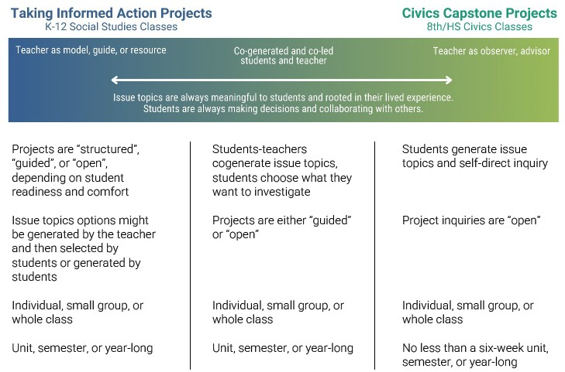
Notes:
The Guidebook outlines two distinct types of civic action projects that students will engage with throughout their K-12 education. The first are "Taking Informed Action Projects,” as articulated by the C3 Framework, which culminate the inquiry process across all grade levels. These projects serve as a summative assessment, allowing students to apply their learning in social, political, environmental, or economic contexts.
The second type are "Civics Capstone Projects," which are more comprehensive, student-led projects that RIDE recommends act as the student-led civics project as outlined in legislation {RIGL §16-22-2}. As stated in the legislation, these are to be completed in middle or high school as a graduation requirement beginning with the class of 2028. Civics Capstone Projects represent a culmination of the civic knowledge, skills, and dispositions students will have developed since kindergarten, requiring them to identify a community issue, conduct research, and implement a solution.
Note that the idea here follows what we just talked about with structured inquiry and open inquiry – RIDE’s vision is that students will have experienced projects throughout their K-12 education, so that when they are working on the project for graduation, the “Capstone,” it is not their first time. Therefore, this project will be truly student-led and robust. This will take planning within K-12 teams deciding where to include Taking Informed Action Projects so that students are prepared for their Capstone.
Also note that the Capstone should be no less than a 6-week unit.

Slide 47
Civic Action Projects
Project Phases
Phase 1: Reinforce a Supportive Community
Phase 2: Develop Questions & Plan Inquiry
Phase 3: Conduct Research
Phase 4: Analyze & Draw Conclusions
Phase 5: Identify Solutions and Plan for Action
Phase 6: Implement and Reflect
Notes:
{This Slide is Animated} Here are the project phases. These are the phases whether students are working on a Taking Informed Action Project or a Civics Capstone Project. Notice how the Civic Learning Practices {click} are incorporated into the project phases. The majority of the Civic Learning Practices are essential for successful projects, and educators therefore will not want to skip over Part 3 of the Guidebook.
In Phase 1, teachers work with students to reinforce a supportive classroom community by establishing classroom norms, agreements, and ways of working together, creating a safe, inclusive environment where diverse perspectives are valued, and students feel comfortable sharing their experiences and ideas. Educators will hopefully be “reinforcing” this if they already established a positive classroom environment through Core Practice 2.
In Phase 2, students identify topics of interest for their inquiry projects. The teacher provides guidance on generating compelling questions that drive the inquiry process. Students plan their research by identifying key subtopics, determining what information they need, and strategizing how they will gather it.
In Phase 3, students engage in extensive research to deepen their understanding of the issue. They investigate the historical, social, economic, and political factors contributing to the problem and seek out perspectives from those most impacted by it. Students use a variety of credible sources, such as academic articles, government reports, news media, and interviews with experts or community members. Throughout the research process, students participate in dialogic and deliberative activities to process, synthesize, and make meaning of the information they collect.
During Phase 4, students analyze the information gathered during their research to identify patterns, trends, and key insights. They evaluate the credibility and relevance of their sources and draw evidence-based conclusions about the nature of the problem and potential solutions. Students communicate their findings and conclusions through authentic assessments such as reflective essays, argumentative papers, deliberations, or presentations. These products should demonstrate students' growth in knowledge, critical thinking, and civic engagement. Students reflect on their personal learning journey and the implications of their findings for themselves and their community. After reflecting on their conclusions and solutions, students identify their action(s).
In Phase 5, students develop a plan of action to address the issue based on their research and analysis. They consider various strategies, such as raising awareness, advocating for policy changes, or collaborating with community organizations. Students assess the feasibility and potential impact of each approach and determine the most effective course of action.
In Phase 6, the culminating phase, students implement their action plan to the extent possible within the project timeline. Throughout the implementation process, students reflect on challenges, successes, and personal growth. The project concludes with a celebration and reflection event where students share their experiences, key learnings, and the impact of their actions. This event may involve the class, school community, or wider public, depending on students' preferences and the nature of their projects.
As you can see from the descriptions of the project phases, the Civic Learning Practices come into play within the phase(s) of the project.
{Some notes for the facilitator to help attendees connect the Civic Learning Practices to the project phases}
CP 1: Inquiry – all Phases (the visual on the next slide show how they are directly connected.)
CP 2: Nurture Voice and Inclusive Culture goes along with Phase 1. This should have been established in the classroom already which is why we are “reinforcing” in this phase.
SP 1: Explore complexity – All Phases
SP 2: Engage in Dialogue and Deliberation – All phases, but it is mentioned specifically in Phase 3
SP 3: Participate through community-connected learning – phases 3, 5, and 6
SP 4: Experience simulations – This may not come into play with projects since this is a real-life experience, but there may be opportunities to include simulations during the research process or during Phase 6 like having students simulate presenting their solutions in a town hall meeting.
SP 5: Develop Civic Media Literacy – Phases 3 and 4 while doing research and analyzing that research.

Slide 48
Project Phases and the Inquiry Arc
Credit: C3 Inquiry Arc Framework
Phase 1: Reinforce a Supportive Community
Phase 2: Develop Questions and Plan Inquiry
Phase 3: Conduct Research
Phase 4: Analyze & Draw Conclusions
Phase 3: Conduct Research
Phase 4: Analyze & Draw Conclusions
Phase 5: Identify Solutions and Draw Conclusions
Phase 6: Implement and Reflect
Notes:
The project phases line up with the dimensions of the Inquiry Arc. Dimensions 2 and 3 intersect with the same phases because students are researching and analyzing through the lenses of each dimension.
Dimension one – students are choosing their issue and developing questions about their issue.
Dimension two – students are conducting research and analyzing that research through disciplinary lenses – contextualizing the issue (i.e., what is the history of the issue, how does place (geography) affect the issue, how do economics affect the issue, what laws exist that affect the issue or what civic actions have people tried to solve the issue).
Dimension three – students are conducting research and analyzing that research through the lens of multiple perspectives on the issue, weighing evidence, and understanding bias.
Dimension four – students identify and communicate their conclusions, implement their action, and reflect.

Slide 49
Civic Action Projects
Project Implementation Suggestions:
Types of Civic Action
Classroom Project Size
Topic Selection Guidance
Scope and Timeline Suggestions
Assessment Strategies
Notes:
The Guidebook also includes extensive information about the following project implementation suggestions…
Types of Civic Action
Classroom Project Size
Topic Selection Guidance
Scope and Timeline Suggestions
Assessment Strategies

Slide 50
Civic Action Projects
Assessment Note:
Teachers are assessing the process and student learning, not whether students followed through on an action or if their action was successful
Notes:
A note about assessing projects: Teachers are assessing the process and student learning, not whether students followed through on an action or if their action was successful

Slide 51
Civic Action Projects
Project Implementation Help:
Strategies for ensuring inclusive, responsive, and engaging projects
Strategies for connecting with community
Strategies to support Multilingual Learners
Strategies to support Differently-Abled Students
Resources for teachers – potential partners, frameworks, and toolkits
Notes:
The Guidebook also has strategies to help with project implementation such as....
Strategies for ensuring inclusive, responsive, and engaging projects
Strategies for connecting with community
Strategies to support Multilingual Learners
Strategies to support Differently-Abled Students
Resources for teachers – potential partners, frameworks, and toolkits
Please note that the strategies for connecting with community can be found in the Guidebook under Supporting Practice #3. There is also a list of local RI civic leaders and organizations there.

Slide 52
Preparing Students for Civic Readiness
Beginning Implementation:
Implementing Inquiry and the Civic Learning Practices will take time. Teachers can start by trying a small inquiry if you are new to it
K-12 teams need to work together to plan ways to start incorporating increasingly robust civic action projects at different grade levels
Plan to lead up to a robust, student-led Civics Capstone Project whether the project is placed in middle or high school
Inform all K-12 teachers of the Guidebook as the Civic Learning Practices and Taking Informed Action Projects are not just for civics classes
The Guidebook is packed with information and links to resources
Notes:
You may be thinking “where do we start?” with implementing the Practices and the projects.
Teachers new to the inquiry process or to applying inquiry using the method outlined in the C3 Framework, should start small by piloting a guided inquiry with their classes.
K-12 teams and school or district leadership need to work together to make decisions on where to incorporate increasingly robust Taking Informed Action Projects across the grade levels.
Make sure that plan takes into account when students are expected to complete the Civics Capstone Project, whether that is in eight grade or high school.
Inform colleagues about the Guidebook as the Civic Learning Practices and Taking Informed Action Projects are not just for civics classes.
Information in this presentation only scratched the surface of what is in the Guidebook. Look to the Guidebook for more information, strategies, and links to resources and tools.

Slide 53
Thank you!
RIDE Contact:
Education Specialist, Humanities and Social Studies
socialstudies@ride.ri.gov

